Slide 1
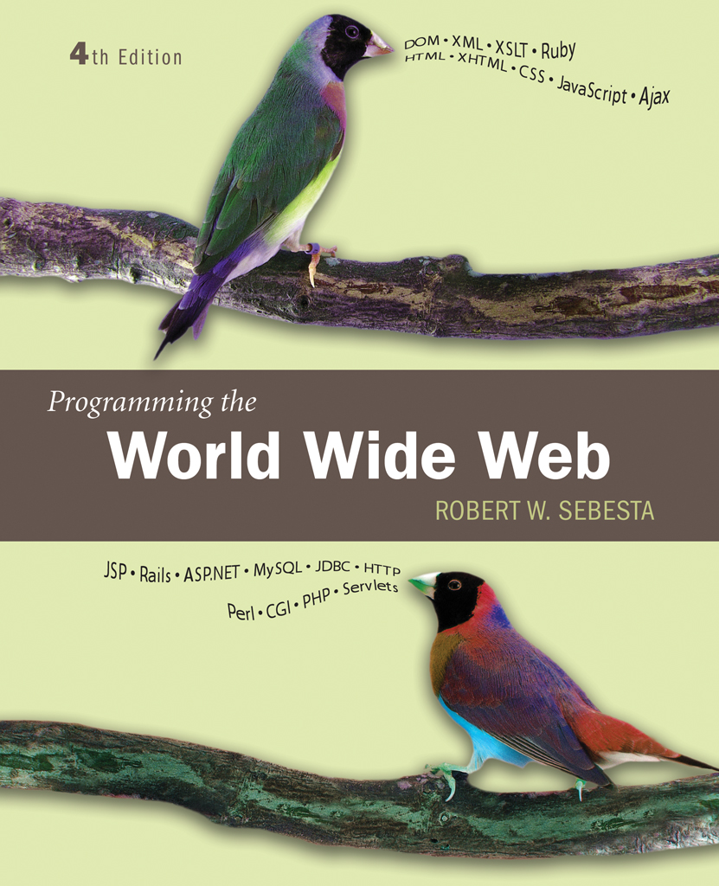
Chapter 1
Fundamentals

Slide 2
1.1 A Brief Intro to the Internet
Internet History
Internet Protocols

Slide 3
1.1 Internet History
Origins
  ARPAnet - late 1960s and early 1970s
    Network reliability
    For ARPA-funded research organizations
BITnet, CSnet - late 1970s & early 1980s
    email and file transfer for other institutions
  NSFnet - 1986
    Originally for non-DOD funded places
    Initially connected five supercomputer centers
    By 1990, it had replaced ARPAnet for non-military uses
    Soon became the network for all (by the early 1990s)
  NSFnet eventually became known as the Internet

Slide 4
1.1 Internet History
What the Internet is:
    A world-wide network of computer networks
    At the lowest level, since 1982, all connections use TCP/IP
    TCP/IP hides the differences among devices connected to the Internet

Slide 5
1.1 Internet Protocols
Internet Protocol (IP) Addresses
  Every node has a unique numeric address
  Form: 32-bit binary number
    New standard, IPv6, has 128 bits (1998)
Organizations are assigned groups of IPs for their computers
Problem: By the mid-1980s, several different protocols had been invented and were being used on the Internet, all with different user interfaces (Telnet, FTP, Usenet, mailto)

Slide 6
1.1 Internet Protocols
Domain names
  Form: host-name.domain-names
  First domain is the smallest; last is the largest
  Last domain specifies the type of organization
  Fully qualified domain name - the host name and all of the domain names
  DNS servers - convert fully qualified domain names to IPs

Slide 7
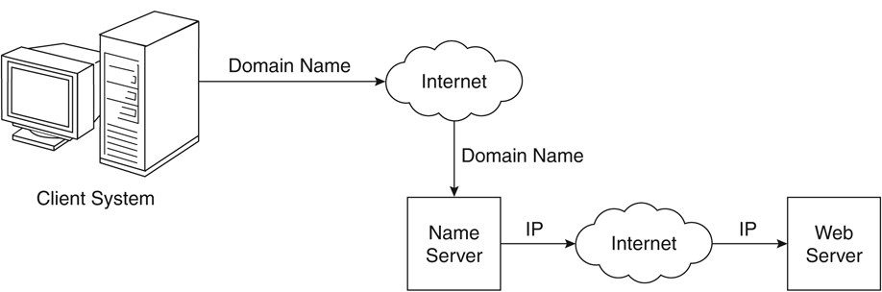
Figure 1.1 Domain name conversion

Slide 8
Client and Server
Clients and Servers are programs that communicate with each other over the Internet
A Server runs continuously, waiting to be contacted by a Client
  Each Server provides certain services
  Services include providing web pages
A Client will send a message to a Server requesting the service provided by that server
  The client will usually provide some information, parameters, with the request

Slide 9
1.2 The World-Wide Web
A possible solution to the large number of different protocols being used on the Internet
Origins
  Tim Berners-Lee at CERN proposed the Web in 1989
    Purpose: to allow scientists to have access to many databases of scientific work through their own computers
  Document form: hypertext
  Pages? Documents? Resources?
    We’ll call them documents
  Hypermedia – more than just text – images, sound, etc.

Slide 10
1.2 The World-Wide Web
Web or Internet?
  The Web uses one of the protocols, http, that runs on the Internet--there are several others (telnet, mailto, etc.)

Slide 11
1.3 Web Browsers
Browsers are clients - always initiate, servers react (although sometimes servers require responses)
Mosaic - NCSA (Univ. of Illinois), in early 1993
  First to use a GUI, led to explosion of Web use
  Initially for X-Windows, under UNIX, but was ported to other platforms by late 1993
Most requests are for existing documents, using HyperText Transfer Protocol (HTTP)
  But some requests are for program execution, with the output being returned as a document
Name some of the Web Browsers?

Slide 12
1.4 Web Servers
Provide responses to browser requests, either existing documents or dynamically built documents
Browser-server connection is now maintained through more than one request-response cycle
All communications between browsers and servers use Hypertext Transfer Protocol (HTTP)
Port number for HTTP? and HTTPS?

Slide 13
1.4 Web Server Operation
Web servers run as background processes in the operating system
  Monitor a communications port on the host, accepting HTTP messages when they appear
All current Web servers came from either
    The original from CERN
    The second one, from NCSA
Most common server now is Apache

Slide 14
1.4 Web Server Operation Details
The file structure of Web servers have two main directories:
    Document root (servable documents)
    Server root (server system software)
Document root is accessed indirectly by clients
  Its actual location is set by the server configuration file
  Requests are mapped to the actual location
Virtual document trees (servable documents from the secondary areas)
Virtual hosts (servers support more than one site on a computer
Proxy servers (Servers serving documents from the document root of other machine)
Web servers now support other Internet protocols

Slide 15
1.4 Web Server Operation : Apache
Apache (open source, fast, reliable)
3 config files of Apache server:
  Httpd.conf
  Srm.conf
  Access.conf
Different directives are available in
http://httpd.apache.org/docs/2.2/mod/quickreference.html
Basically designed for UNIX systems

Slide 16
1.4 Web Server Operation : IIS
IIS for windows systems
  Operation is maintained through a program (IIS snap-in) with a GUI interface
  Operations of Apache is controlled by configuration files

Slide 17
1.5 URLs
General form:
  Format: object-address
  The scheme is often a communications protocol, such as telnet or ftp
For the http protocol, the object-address is:
//fully-qualified-domain-name/path-to-document
For the file protocol, only the doc path is needed
file://path-to-document

Slide 18
1.5 URLs
Host name may include a port number, as in zeppo:80 (80 is the default, so this is silly)
URLs cannot include spaces or any of a collection of other special characters (semicolons, colons, ...)
The doc path may be abbreviated as a partial path
  The rest is furnished by the server configuration
If a special character has to be entered then % with its hexadecimal ASCII code should be included
Eg: if domain name ‘RV CE’ has to be specfied then it has to be written as ‘RV%20CE’ (20 is ASCII code for space)

Slide 19
1.6 Multipurpose Internet Mail Extensions (MIME)
Used by the browsers for deciding the format of doc received by the web server
Originally developed for email
Attached by the server to the beginning of the document
Type specifications
  Form:
    type/subtype
  Common types are: text, image and video
  Common subtypes are: plain, html, gif, jpeg, mpeg, quicktime
  Examples: text/plain, text/html, image/gif, image/jpeg

Slide 20
1.6 Multipurpose Internet Mail Extensions (MIME)
Server gets type from the requested file name’s suffix (.html implies text/html)
Browser gets the type explicitly from the server
Experimental sub types
Subtype begins with x-
e.g., video/x-msvideo
Experimental types require the server to send a helper application or plug-in so the browser can deal with the file

Slide 21
1.7 The HyperText Transfer Protocol
The protocol used by ALL Web communications
Request Phase
  Form:
  HTTP method domain part of URL HTTP ver.
  Header fields
  blank line
  Message body
  An example of the first line of a request:
    GET /degrees.html HTTP/1.1

Slide 22
1.7 The HyperText Transfer Protocol: Methods
GET - Fetch a document
POST - Execute the document, using the data in body
HEAD - Fetch just the header of the document
PUT - Store a new document on the server
DELETE - Remove a document from the server

Slide 23
1.7 HTTP Headers
Four categories of header fields:
  General, request, response, & entity
Common request fields:
  Accept: text/plain
  Accept: text/*
  If-Modified_since: date
Common response fields:
  Content-length: 488
  Content-type: text/html
Can communicate with HTTP without a browser
  > telnet blanca.uccs.edu http
  GET /respond.html HTTP/1.1
  Host: blanca.uccs.edu

Slide 24
1.7 HTTP Response
Form:
  Status line
  Response header fields
  blank line
  Response body
Status line format:
  HTTP version status code explanation
Example: HTTP/1.1 200 OK
  (Current version is 1.1)
Status code is a three-digit number; first digit specifies the general status
  1 => Informational
  2 => Success
  3 => Redirection
  4 => Client error
  5 => Server error
The header field, Content-type, is required

Slide 25
1.7 HTTP Response Example
HTTP/1.1 200 OK
Date: Tues, 18 May 2004 16:45:13 GMT
Server: Apache (Red-Hat/Linux)
Last-modified: Tues, 18 May 2004 16:38:38 GMT
Etag: "841fb-4b-3d1a0179"
Accept-ranges: bytes
Content-length: 364
Connection: close
Content-type: text/html, charset=ISO-8859-1
Both request headers and response headers must be followed by a blank line

Slide 26
1.7 Status code Example
Example for status code are
  404 --- file not found
  200 --- OK
  500 --- Server encountered a problem

Slide 27
1.8 Security
Both Web Browsers and Servers are unsafe !!!??
Security issues are
  Privacy: it shouldn’t be possible to steal the data while transmitting
  Integrity: it shouldn’t be possible to modify the data while transmitting
  Authentication: it should be possible for both ends to be certain of each others identity
  Nonrepudiation: it should be possible to legally prove that the message was actually sent and received
Encryption is the tool for resolving security issues
  Symmetric key encryption
  Public key encryption

Slide 28
1.8 Security
Some more security problems are
  DoS
  Viruses
  Worms

Slide 29
Chapter 2
Introduction to
XHTML

Slide 30
2.1 Origins and Evolution of HTML and XHTML
HTML was defined with SGML (Standard Generalized Markup Language)
Original intent of HTML: General layout of documents that could be displayed by a wide variety of browsers
Recent versions:
  HTML 4.0 – 1997
    Introduced many new features and deprecated many older features
  HTML 4.01 - 1999 - A cleanup of 4.0
  XHTML 1.0 - 2000
    Just 4.01 defined using XML, instead of SGML
  XHTML 1.1 – 2001
    Modularized 1.0, and drops frames
    We’ll stick to 1.1, except for frames

Slide 31
2.1 Origins and Evolution of HTML and XHTML (continued)
Reasons to use XHTML, rather than HTML:
  HTML has lax syntax rules, leading to sloppy and sometime ambiguous documents
  – XHTML syntax is much more strict, leading to clean and clear documents in a standard form
  HTML processors do not even enforce the few syntax rules that do exist in HTML
  The syntactic correctness of XHTML documents can be validated
2.2 Basic Syntax
Elements are defined by tags (categories of content)
  Tag format:
    Opening tag: <name>
    Closing tag: </name>
  The opening tag and its closing tag together specify a container for the content they enclose

Slide 32
2.2 Basic Syntax (continued)
Not all tags have content
  If a tag has no content, its form is <name />
The container and its content together are called an element
If a tag has attributes, they appear between its name and the right bracket of the opening tag
Comment form: <!-- … -->
Browsers ignore comments, unrecognizable tags, line breaks, multiple spaces, and tabs
Tags are suggestions to the browser

Slide 33
2.3 XHTML Document Structure
Every XHTML document must begin with an xml declaration element:
  <?xml version = ″1.0″?>
  <!DOCTYPE html PUBLIC ″-//w3c//DTD XHTML 1.1//EN″
  http://www.w3.org/TR/xhtml11/DTD/xhtml11.dtd>
<html>, <head>, <title>, and <body> are required in every document
The whole document must have <html> as its root
html must have the xmlns attribute:
<html xmlns = ″http://www.w3.org/1999/xhtml″
A document consists of a head and a body
The <title> tag is used to give the document a title, which is normally displayed in the browser’s window title bar (at the top of the display)
Prior to XHTML 1.1, a document could have either a body or a frameset

Slide 34
2.4 Basic Text Markup
Text is normally placed in paragraph elements
Paragraph Elements
  The <p> tag breaks the current line and inserts a blank line - the new line gets the beginning of the content of the paragraph
  The browser puts as many words of the paragraph’s content as will fit in each line
  <?xml version = ″1.0″?>
  <!DOCTYPE html PUBLIC ″-//w3c//DTD XHTML 1.1//EN″
  http://www.w3.org/TR/xhtml11/DTD/xhtml11.dtd>
  <!-- greet.hmtl
  A trivial document
  -->
  <html xmlns = ″http://www.w3.org/1999/xhtml″>
  <head> <title> Our first document </title>
  </head>
  <body>
  <p>
  Greetings from your Webmaster!
  </p>
  </body>
  </html>

Slide 35
2.4 Basic Text Markup (continued)
2. Line breaks
  The effect of the <br /> tag is the same as that of <p>, except for the blank line
    No closing tag!
Example of paragraphs and line breaks
  On the plains of hesitation <p> bleach the
  bones of countless millions </p> <br />
  who, at the dawn of victory <br /> sat down
  to wait, and waiting, died.
Typical display of this text:
  On the plains of hesitation
  bleach the bones of countless millions
  who, at the dawn of victory
  sat down to wait, and waiting, died.

Slide 36
2.4 Basic Text Markup (continued)
3. Preserving white spaces
  Using the tag <pre> </pre> the whitespaces can be preserved
  Example:
  <p><pre>
  RVCE
  CSE
  DEPT
  </pre></p>
4. Headings
  Six sizes, 1 - 6, specified with <h1> to <h6>
  1, 2, and 3 use font sizes that are larger than the default font size
  4 uses the default size
  5 and 6 use smaller font sizes
Example Headings.html

Slide 37
2.4 Basic Text Markup (continued)
5. Blockquotes
  Content of <blockquote>
  To set a block of text off from the normal flow and appearance of text
  Browsers often indent, and sometimes italicize
6. Font Styles and Sizes (can be nested)
  Boldface - <b>
  Italics - <i>
  Emphasis - <em>
  Strong - <strong>
  Superscript - <sup>
  Subscript - <sub>

Slide 38
2.4 Basic Text Markup (continued)
  Example: x<sub>2</sub><sup>3</sup>
  Display: x₂³
7. Character Entities
Char. Entity Meaning
& &amp; Ampersand
< &lt; Less than
> &gt; Greater than
” &quot; Double quote
’ &apos; Single quote
¼ &frac14; One quarter
½ &frac12; One half
¾ &frac34; Three quarters
° &deg; Degree
(space) &nbsp; Non-breaking space

Slide 39
2.4 Basic Text Markup (continued)
8. Horizontal rules
    <hr /> draws a line across the display, after a line break
9. meta Element
For search engines to categorize the document
Used to provide additional information about a document, with attributes, not content
Example:
<meta name = “Title” content = “3 mistakes of my life” />
W3C HTML Validation Service
  http://validator.w3.org/file-upload.html

Slide 40
2.5 Images
GIF (Graphic Interchange Format)
  8-bit color (256 different colors)
JPEG (Joint Photographic Experts Group)
  24-bit color (16 million different colors)
Both use compression, but JPEG compression is better
Images are inserted into a document with the <img /> tag with the src attribute
  The alt attribute is required by XHTML
    Purposes:
      Non-graphical browsers
      Browsers with images turned off
  <img src = "comets.jpg"
alt = "Picture of comets" />
The <img> tag has 30 different attributes, including width and height (in pixels)
Portable Network Graphics (PNG)
  Relatively new
  Should eventually replace both gif and jpeg

Slide 41
2.5 Images (continued)
<!-- image.html
An example to illustrate an image
-->
<html xmlns = ″http://www.w3.org/1999/xhtml″>
<head> <title> Images </title>
</head>
<body>
<h1> Aidan's Airplanes </h1>
<h2> The best in used airplanes </h2>
<h3> "We've got them by the hangarful"
</h3>
<h2> Special of the month </h2>
<p>
1960 Cessna 210 <br />
577 hours since major engine overhaul
<br />
1022 hours since prop overhaul
<br /><br />
<img src = "c210new.jpg"
alt = "Picture of a Cessna 210"/>
<br />
Buy this fine airplane today at a
remarkably low price <br />
Call 999-555-1111 today!
</p>
</body>
</html>

Slide 42
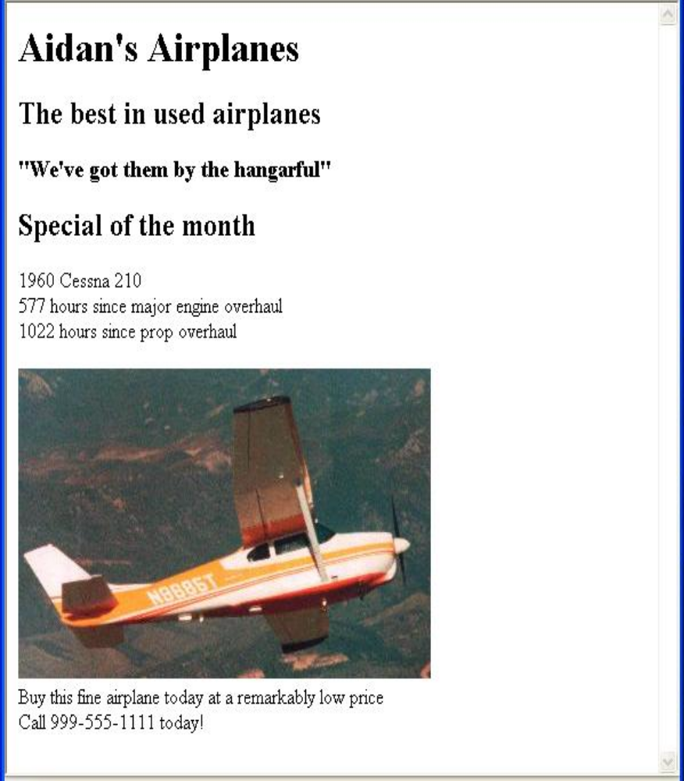
2.5 Images (continued)

Slide 43
2.6 Hypertext Links
2.6.1 Links
Hypertext is the essence of the Web!
A link is specified with the href (hypertext reference) attribute of <a> (the anchor tag)
  The content of <a> is the visual link in the document
  If the target is a whole document (not the one in which the link appears), the target need not be specified in the target document as being the target
Note: Relative addressing of targets is easier to maintain and more portable than absolute addressing

Slide 44
2.6 Hypertext Links (continued)
<!-- link.html
An example to illustrate a link
-->
<html xmlns = ″http://www.w3.org/1999/xhtml″>
<head> <title> Links </title>
</head>
<body>
<h1> Aidan's Airplanes </h1>
<h2> The best in used airplanes </h2>
<h3> "We've got them by the hangarful"
</h3>
<h2> Special of the month </h2>
<p>
1960 Cessna 210 <br />
<a href = "C210data.html">
Information on the Cessna 210 </a>
</p>
</body>
</html>

Slide 45
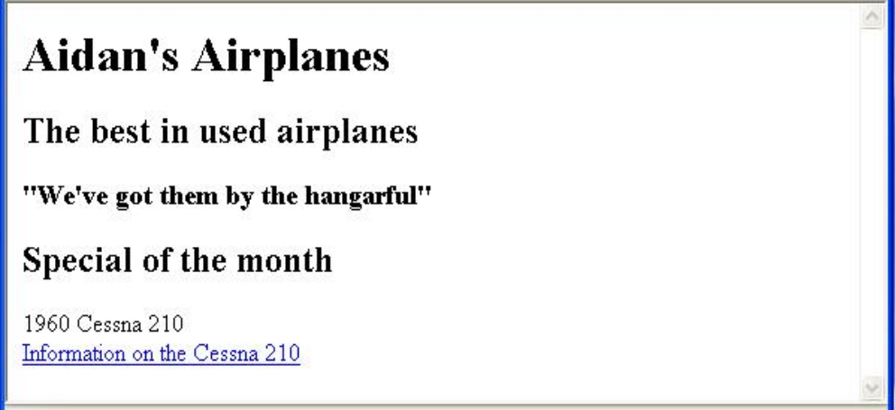
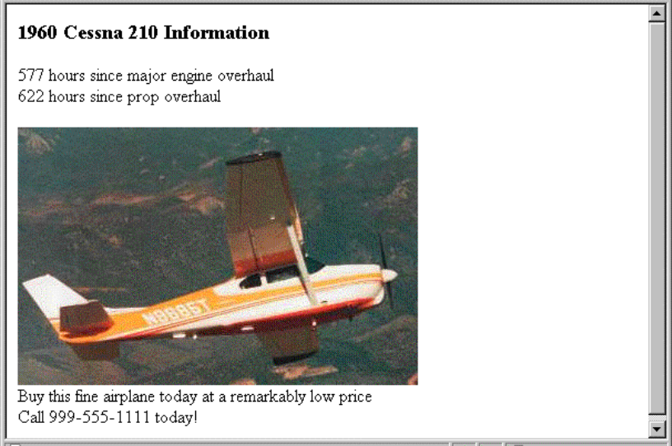
2.6 Hypertext Links (continued)

Slide 46
2.6 Hypertext Links (continued)
2.6.2 Target within documents
If the target is not at the beginning of the document, the target spot must be marked
Target labels can be defined in many different tags with the id attribute, as in
  <h1 id = "baskets"> Baskets </h1>
The link to an id must be preceded by a pound sign (#); If the id is in the same document, this target could be
  <a href = "#baskets">
What about baskets? </a>
If the target is in a different document, the document reference must be included
  <a href = "myAd.html#baskets”> Baskets </a>
Style note: a link should blend in with the surrounding text, so reading it without taking the link should not be made less pleasant
Links can have images:
<a href = "c210data.html“>
<img src = "smallplane.jpg"
alt = "Small picture of an airplane " />
Info on C210 </a>

Slide 47
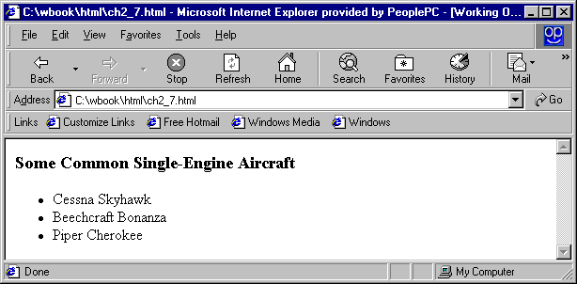
2.7 Lists
Unordered lists
The list is the content of the <ul> tag
List elements are the content of the <li> tag
<h3> Some Common Single-Engine Aircraft </h3>
<ul>
<li> Cessna Skyhawk </li>
<li> Beechcraft Bonanza </li>
<li> Piper Cherokee </li>
</ul>
Ordered lists
  The list is the content of the <ol> tag
  Each item in the display is preceded by a sequence value

Slide 48
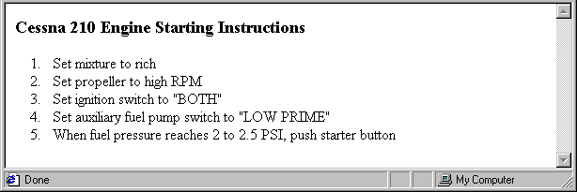
2.7 Lists (continued)
<h3> Cessna 210 Engine Starting Instructions
</h3>
<ol>
<li> Set mixture to rich </li>
<li> Set propeller to high RPM </li>
<li> Set ignition switch to "BOTH" </li>
<li> Set auxiliary fuel pump switch to
"LOW PRIME" </li>
<li> When fuel pressure reaches 2 to 2.5
PSI, push starter button </li>
</ol>
Nested lists
  Any type list can be nested inside any type list
  The nested list must be in a list item

Slide 49
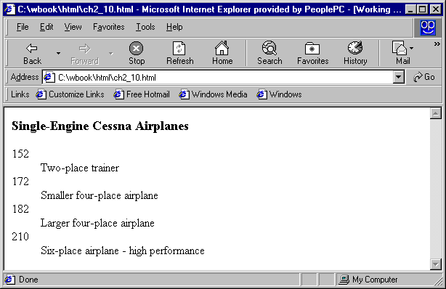
2.7 Lists (continued)
Definition lists (for glossaries, etc.)
  List is the content of the <dl> tag
  Terms being defined are the content of the <dt> tag
  The definitions themselves are the content of the <dd> tag
<h3> Single-Engine Cessna Airplanes </h3>
<dl >
<dt> 152 </dt>
<dd> Two-place trainer </dd>
<dt> 172 </dt>
<dd> Smaller four-place airplane </dd>
<dt> 182 </dt>
<dd> Larger four-place airplane </dd>
<dt> 210 </dt>
<dd> Six-place airplane - high performance
</dd>
</dl>

Slide 50
2.8 Tables
A table is a matrix of cells, each possibly having content
The cells can include almost any element
Some cells have row or column labels and some have data
A table is specified as the content of a <table> tag
A border attribute in the <table> tag specifies a border between the cells
If border is set to "border", the browser’s default width border is used
The border attribute can be set to a number, which will be the border width
Without the border attribute, the table will have no lines!
Tables are given titles with the <caption> tag, which can immediately follow <table>

Slide 51
2.8 Tables (continued)
Each row of a table is specified as the content of a <tr> tag
The row headings are specified as the content of a <th> tag
The contents of a data cell is specified as the content of a <td> tag
<table border = "border">
<caption> Fruit Juice Drinks </caption>
<tr>
<th> </th>
<th> Apple </th>
<th> Orange </th>
<th> Screwdriver </th>
</tr>
<tr>
<th> Breakfast </th>
<td> 0 </td>
<td> 1 </td>
<td> 0 </td>
</tr>
<tr>
<th> Lunch </th>
<td> 1 </td>
<td> 0 </td>
<td> 0 </td>
</tr>
</table>

Slide 52
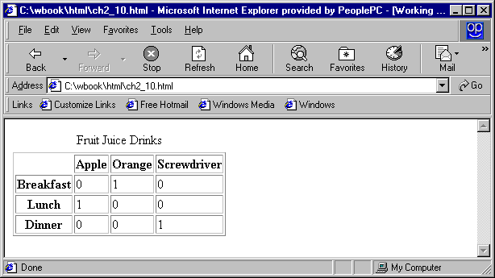
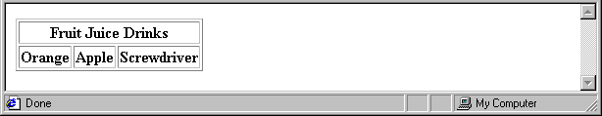
2.8 Tables (continued)
A table can have two levels of column labels
  If so, the colspan attribute must be set in the <th> tag to specify that the label must span some number of columns
<tr>
<th colspan = "3"> Fruit Juice Drinks </th>
</tr>
<tr>
<th> Orange </th>
<th> Apple </th>
<th> Screwdriver </th>
</tr>

Slide 53
2.8 Tables (continued)
If the rows have labels and there is a spanning column label, the upper left corner must be made larger, using rowspan
<table border = "border">
<tr>
<td rowspan = "2"> </td>
<th colspan = "3"> Fruit Juice Drinks
</th>
</tr>
<tr>
<th> Apple </th>
<th> Orange </th>
<th> Screwdriver </th>
</tr>
…
</table>

Slide 54
2.8 Tables (continued)
The align attribute controls the horizontal placement of the contents in a table cell
  Values are left, right, and center (default)
  align is an attribute of <tr>, <th>, and <td> elements
The valign attribute controls the vertical placement of the contents of a table cell
  Values are top, bottom, and center (default)
  valign is an attribute of <th> and <td> elements
  → SHOW cell_align.html and display it
The cellspacing attribute of <table> is used to specify the distance between cells in a table
The cellpadding attribute of <table> is used to specify the spacing between the content of a cell and the inner walls of the cell

Slide 55
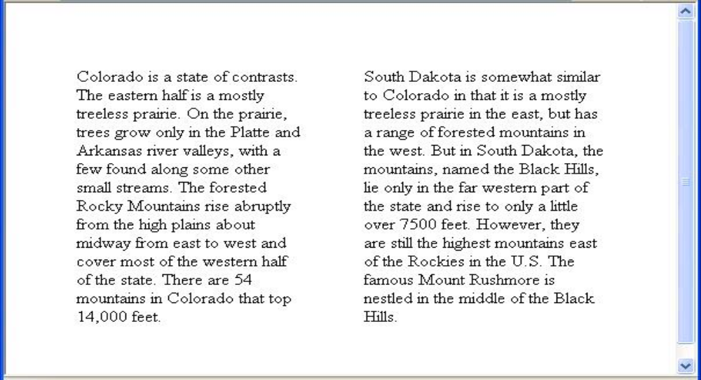
2.8 Tables (continued)
<table cellspacing = "50">
<tr>
<td> Colorado is a state of …
</td>
<td> South Dakota is somewhat…
</td>
</tr>
</table>
Table Sections
  Header, body, and footer, which are the elements: thead, tbody, and tfoot
  If a document has multiple tbody elements, they are separated by thicker horizontal lines

Slide 56
2.9 Forms
A form is the usual way information is gotten from a browser to a server
XHTML has tags to create a collection of objects that implement this information gathering
  The objects are called widgets (e.g., radio buttons and checkboxes)
When the Submit button of a form is clicked, the form’s values are sent from the web browser to the web server
All of the widgets, or components of a form are defined in the content of a <form> tag
  The only required attribute of <form> is action, which specifies the URL of the application that is to be called when the Submit button is clicked
  action =
  "http://www.cs.ucp.edu/cgi-bin/survey.pl"
    If the form has no action, the value of action is the empty string

Slide 57
2.9 Forms (continued)
The method attribute of <form> specifies one of the two possible techniques of transferring the form data to the server, get or post
  get is the default
In both cases the form data is coded into a text string when the user clicks the submit button
Widgets
  Many are created with the <input> tag
    The type attribute of <input> specifies the kind of widget being created
    Text
      Creates a horizontal box for text input
      Default size is 20; it can be changed with the size attribute
      If more characters are entered than will fit, the box is scrolled (shifted) left

Slide 58
2.9 Forms (continued)
Example: If you enter
      This is web programming class
  The text box collects whole string but the string would be scrolled to the right leaving the following shown in the box
  eb programming class
  If you don’t want to allow the user to type more characters than will fit, set maxlength, which causes excess input to be ignored
    <input type = "text" name = “name"
    size = “25“ maxlength = “25” />
2. Checkboxes - to collect multiple choice input
  Every checkbox requires a value attribute, which is the widget’s value in the form data when the checkbox is ‘checked’
    A checkbox that is not ‘checked’ contributes no value to the form data
  By default, no checkbox is initially ‘checked’
  To initialize a checkbox to ‘checked’, the checked attribute must be set to "checked"

Slide 59
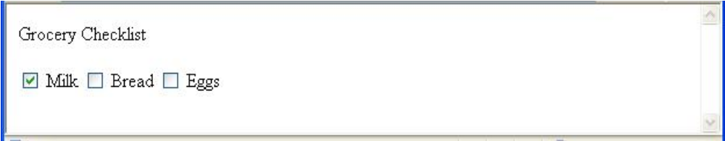
2.9 Forms (continued)
Widgets (continued)
Grocery Checklist
<form action = "">
<p>
<input type = "checkbox" name ="groceries"
value = "milk" checked = "checked">
Milk
<input type = "checkbox" name ="groceries"
value = "bread">
Bread
<input type = "checkbox" name = "groceries"
value= "eggs">
Eggs
</p>
</form>
3. Radio Buttons - collections of checkboxes in which only one button can be ‘checked’ at a time
    Every button in a radio button group MUST have the same name

Slide 60
2.9 Forms (continued)
Widgets (continued)
3. Radio Buttons (continued)
  If no button in a radio button group is ‘pressed’, the browser often ‘presses’ the first one
Age Category
<form action = "">
<p>
<input type = "radio" name = "age"
value = "under20" checked = "checked"> 0-19
<input type = "radio" name = "age"
value = "20-35"> 20-35
<input type = "radio" name = "age"
value = "36-50"> 36-50
<input type = "radio" name = "age"
value = "over50"> Over 50
</p>
</form>

Slide 61
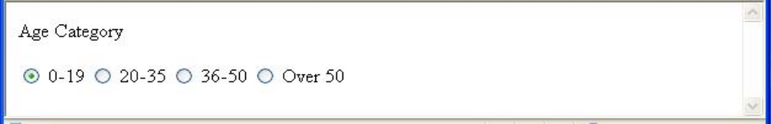
2.9 Forms (continued)
4. Menus - created with <select> tags
There are two kinds of menus, those that behave like checkboxes and those that behave like radio buttons (the default)
  Menus that behave like checkboxes are specified by including the multiple attribute, which must be set to "multiple"
The name attribute of <select> is required
The size attribute of <select> can be included to specify the number of menu items to be displayed (the default is 1)
  If size is set to > 1 or if multiple is specified, the menu is displayed as a pop-up menu

Slide 62
2.9 Forms (continued)
Widgets (continued)
4. Menus (continued)
  Each item of a menu is specified with an <option> tag, whose pure text content (no tags) is the value of the item
  An <option> tag can include the selected attribute, which when assigned "selected” specifies that the item is preselected
Grocery Menu - milk, bread, eggs, cheese
<form action = "">
<p>
With size = 1 (the default)
<select name = "groceries">
<option> milk </option>
<option> bread </option>
<option> eggs </option>
<option> cheese </option>
</select>
</p>
</form>

Slide 63
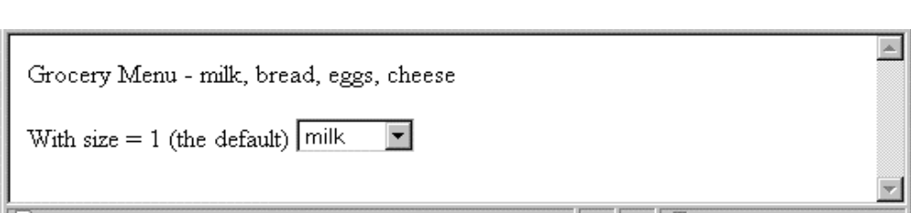
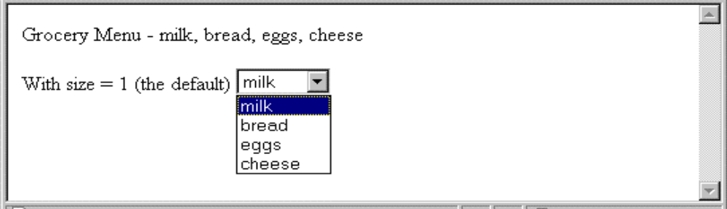
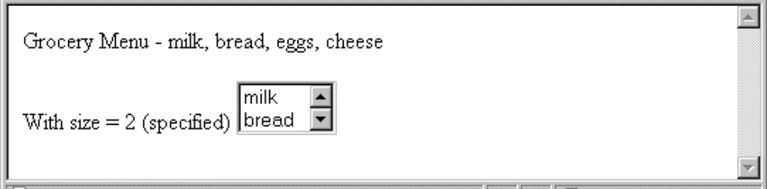
2.9 Forms (continued)
Widgets (continued)
After clicking the menu:
After changing size to 2:

Slide 64
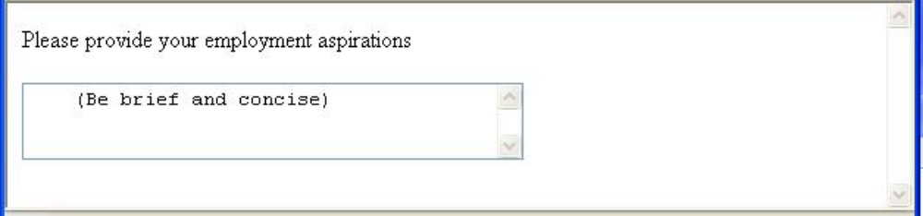
2.9 Forms (continued)
Widgets (continued)
5. Text areas - created with <textarea>
  Usually include the rows and cols attributes to specify the size of the text area
  Default text can be included as the content of <textarea>
  Scrolling is implicit if the area is overfilled
Please provide your employment aspirations
<form action = "">
<p>
<textarea name = "aspirations" rows = "3”
cols = "40">
(Be brief and concise)
</textarea>
</p>
</form>

Slide 65
2.9 Forms (continued)
Widgets (continued)
6. Reset and Submit buttons
  Both are created with <input>
<input type = "reset" value = "Reset Form">
<input type = "submit” value = "Submit Form">
Submit has two actions:
  Encode the data of the form
  Request that the server execute the server-resident program specified as the value of the action attribute of <form>
  A Submit button is required in every form

Slide 66
2.10 Frames
Frames are rectangular sections of the display window, each of which can display a different document
Because frames are no longer part of XHTML, you cannot validate a document that includes frames
The <frameset> tag specifies the number of frames and their layout in the window
  <frameset> takes the place of <body>
  Cannot have both!
  <frameset> must have either a rows attribute or a cols attribute, or both (usually the case)
  Default is 1
  The possible values for rows and cols are numbers, percentages, and asterisks
    A number value specifies the row height in pixels - Not terribly useful!
    A percentage specifies the percentage of total window height for the row - Very useful!

Slide 67
2.10 Frames (continued)
  An asterisk after some other specification gives the remainder of the height of the window
  Examples:
  <frameset rows = "150, 200, 300">
  <frameset rows = "25%, 50%, 25%">
  <frameset rows = "50%, 20%, *" >
  <frameset rows = "50%, 25%, 25%"
  cols = "40%, *">
The <frame> tag specifies the content of a frame
The first <frame> tag in a <frameset> specifies the content of the first frame, etc.
  Row-major order is used
  Frame content is specified with the src attribute
  Without a src attribute, the frame will be empty (such a frame CANNOT be filled later)
If <frameset> has fewer <frame> tags than frames, the extra frames are empty

Slide 68
2.10 Frames (continued)
Scrollbars are implicitly included if needed (they are needed if the specified document will not fit)
If a name attribute is included, the content of the frame can be changed later (by selection of a link in some other frame)
Note: the Frameset standard must be specified in the DOCTYPE declaration

Slide 69
2.10 Frames (continued)
<!-- contents.html
The contents of the first frame of
frames.html, which is the table of
contents for the second frame
-->
<html xmlns = ″http://www.w3.org/1999/xhtml″>
<head> <title> Table of Contents Frame
</title>
</head>
<body>
<h4> Fruits </h4>
<ul>
<li> <a href = "apples.html"
target = "descriptions">
apples </a>
<li> <a href = "bananas.html"
target = "descriptions">
bananas </a>
<li> <a href = "oranges.html"
target = "descriptions">
oranges </a>
</ul>
</body>
</html>

Slide 70
2.10 Frames (continued)
Nested frames - to divide the screen in more interesting ways
→ SHOW nested_frames.html
2.11 Syntactic Differences between HTML & XHTML
Case sensitivity eg: form tag
Closing tags eg:<p>
Quoted attribute values eg:“3”
Explicit attribute values eg:<table border>
id and name attributes
Element nesting

